Slide 1
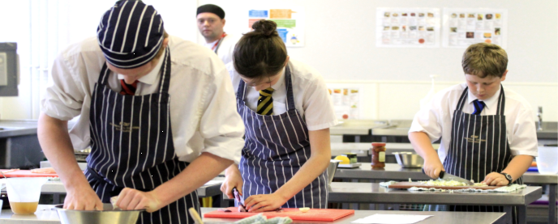
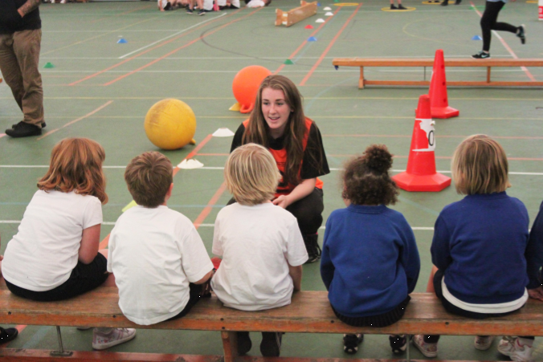
Key Stage 4 :Options
2024-2026

Slide 2
The CORE curriculum
All students study the following
ENGLISH – Literature and Language
MATHS
SCIENCE – Double or Triple
PE (non examination)
PSHE

Slide 3
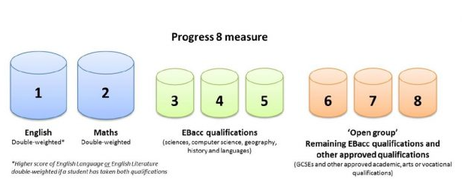

Slide 4
Students will study FOUR option subjects from…
History* | Food
Geography* | Design and Technology
Triple Science* | ICT
French* | Sport and Active Leadership
Spanish* | Photography
Performance & Drama | Business
Music | Design Technology
Art and Design | Engineering
GCSE Statistics & Further maths

Slide 5
The English Baccalaureate
The government “Gold Standard”
Students Study:
English
Mathematics
Science
Humanities (History or Geography)
Foreign Language

Slide 6
Why study ‘the’ Ebacc?

Slide 7
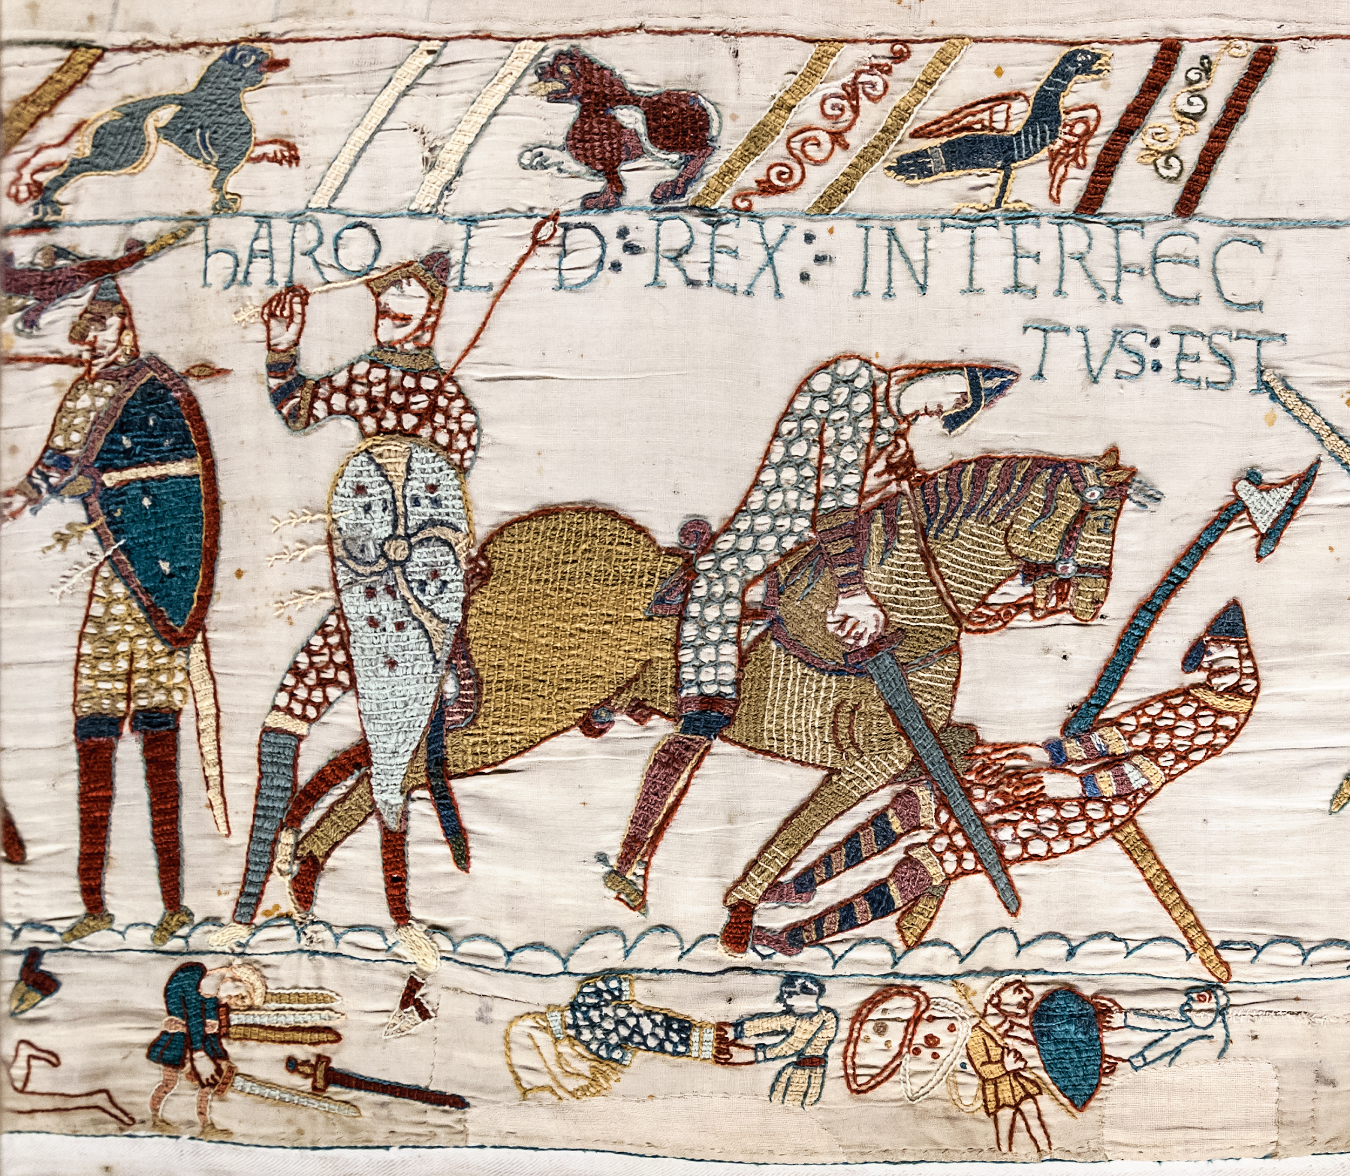
GCSE History
Crime and Punishment in Britain 1000-present (Whitechapel c.1870-1900: crime, policing and the inner city)
A fascinating topic of how crime and punishment has changed from Medieval Britain to the modthe ern day. Students will carry out an in-depth study of Whitechapel murders of ‘Jack the Ripper’ including an investigation into British society in the 1800s.
Weimar and Nazi Germany 1918-1933
This turbulent period of German history allows you to gain an insight into the challenges facing the new Weimar Government in the aftermath of the First World War. You will learn about the rise of the Nazi party, the transition form democracy to dictatorship and the impact of Nazism on the German people.
Anglo-Saxon and Norman England, c1060–88
You will gain an understanding of Anglo Saxon England and how it was controlled. You will learn the rivals for the throne in 1066 and the details of the Battle of Hastings. Finally you will learn how William controlled his new country!
The American West 1840-1895
You will be able to understand the impact of the development of the American West on the lifestyle and culture of the Plains Indians. Students will be able to explain the consequences and importance of various key historical events as well as write clear narrative accounts of the events.

Slide 8
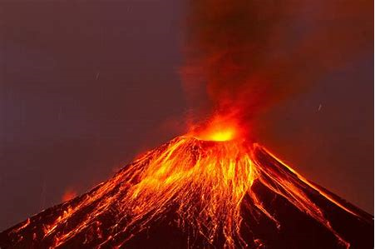
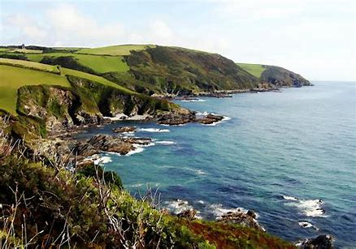
GCSE Geography
You will investigate the safeguarding of our planet through gaining an understanding of climate change, hazard management, globalisation, urban regeneration and sustainable living.
Hazards
You will gain understanding of the hazards that challenge our world: Natural, tectonic and weather hazards and climate change. You will look at why these occur and how they are managed.
Physical landscapes in the UK
You will study the physical landscapes of the UK, the coastal and river landscapes.
The Living World
You will look into Ecosystems, Tropical Rainforests and Cold Desert environments. You will gain understanding of the distinctive characteristics, the opportunities and challenges within these.
Field Work
You will learn the practical applications of Geography.
The challenges in the Human Environment
You will develop an understanding of the factors that produce a diverse variety of human environments through the study of urban issues and challenges, the changing economic world and the challenge of resource management.

Slide 9
Why learn a language?
75% of the world’s population can't speak English.
Languages are highly valued for work especially in business and tourism.
60% of British trade is with non-English speaking countries.
When you can speak a foreign language, you can earn up to 20% more money than someone who only speaks English.
Set yourself apart – not everyone has this skill & its great for self esteem
Communicate with other people in their own language.
Opportunities for travelling or working abroad.
Opportunities to explore other cultures.
Get’s your brain firing more efficiently

Slide 10
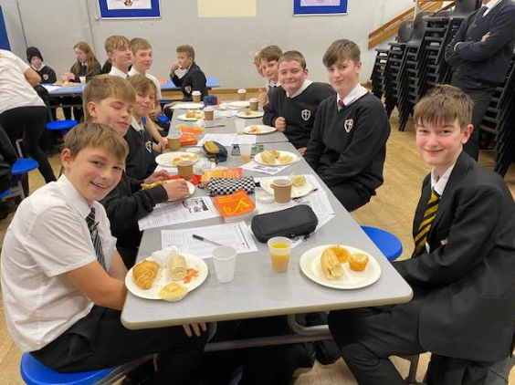
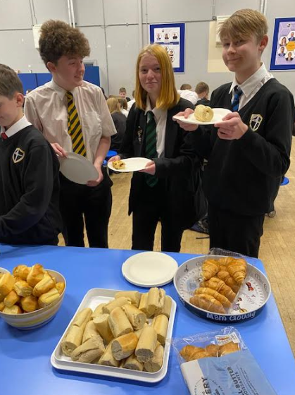
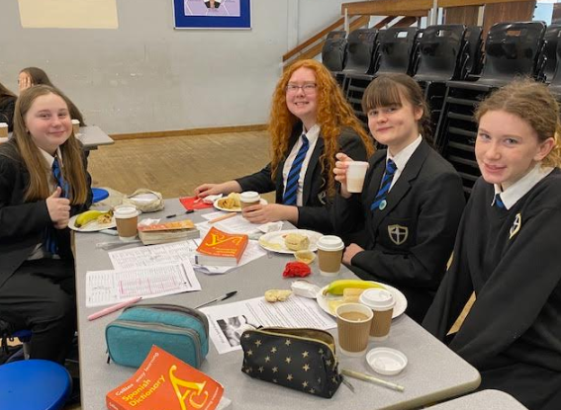

Slide 11
Our advice…….
Keep your options open…..
Career opportunities……
Your strengths……..
NOT……
What teachers you like…..
What your friends are doing….

Slide 12
The curriculum is not written yet…..
Our curriculum will fit for the
vast ‘majority’….
Some courses may not run…

Slide 13
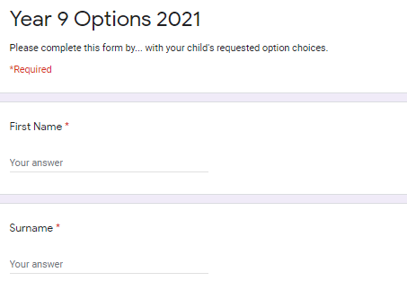
Your Options Forms
Process will start in the spring term

Slide 14
Next steps… Complete online options form
by
March 2025

